Slide 1
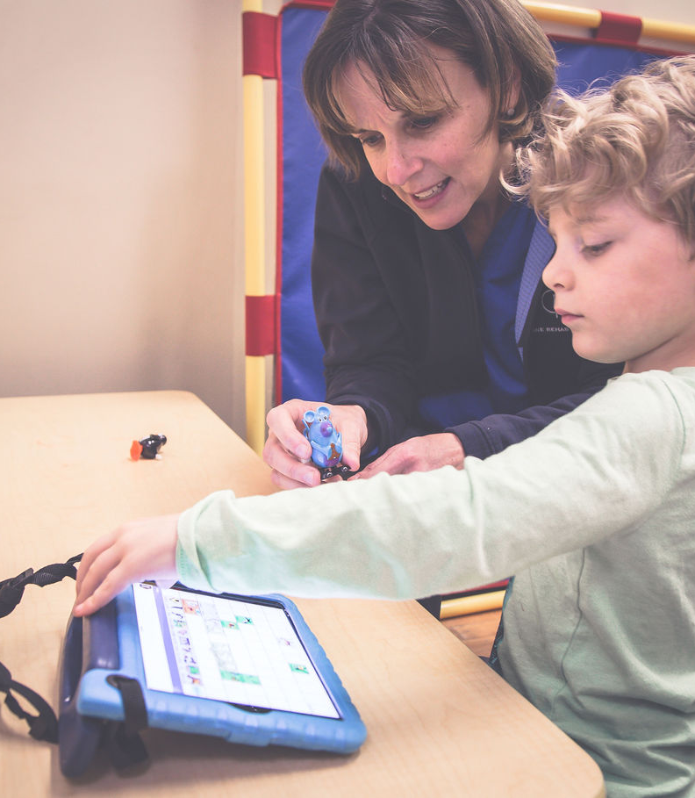
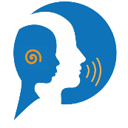
Integrated Mobile Speech Therapy Platform for Child Language Development and Progress Monitoring
SpeechBloom
24-25J-151

Slide 2
Content
Team Members
Snaps from the Field Visits
Overall Project Description
Research Problem
Main Objective
Sub Objectives
Overall System Diagram
References
Individual Components

Slide 3
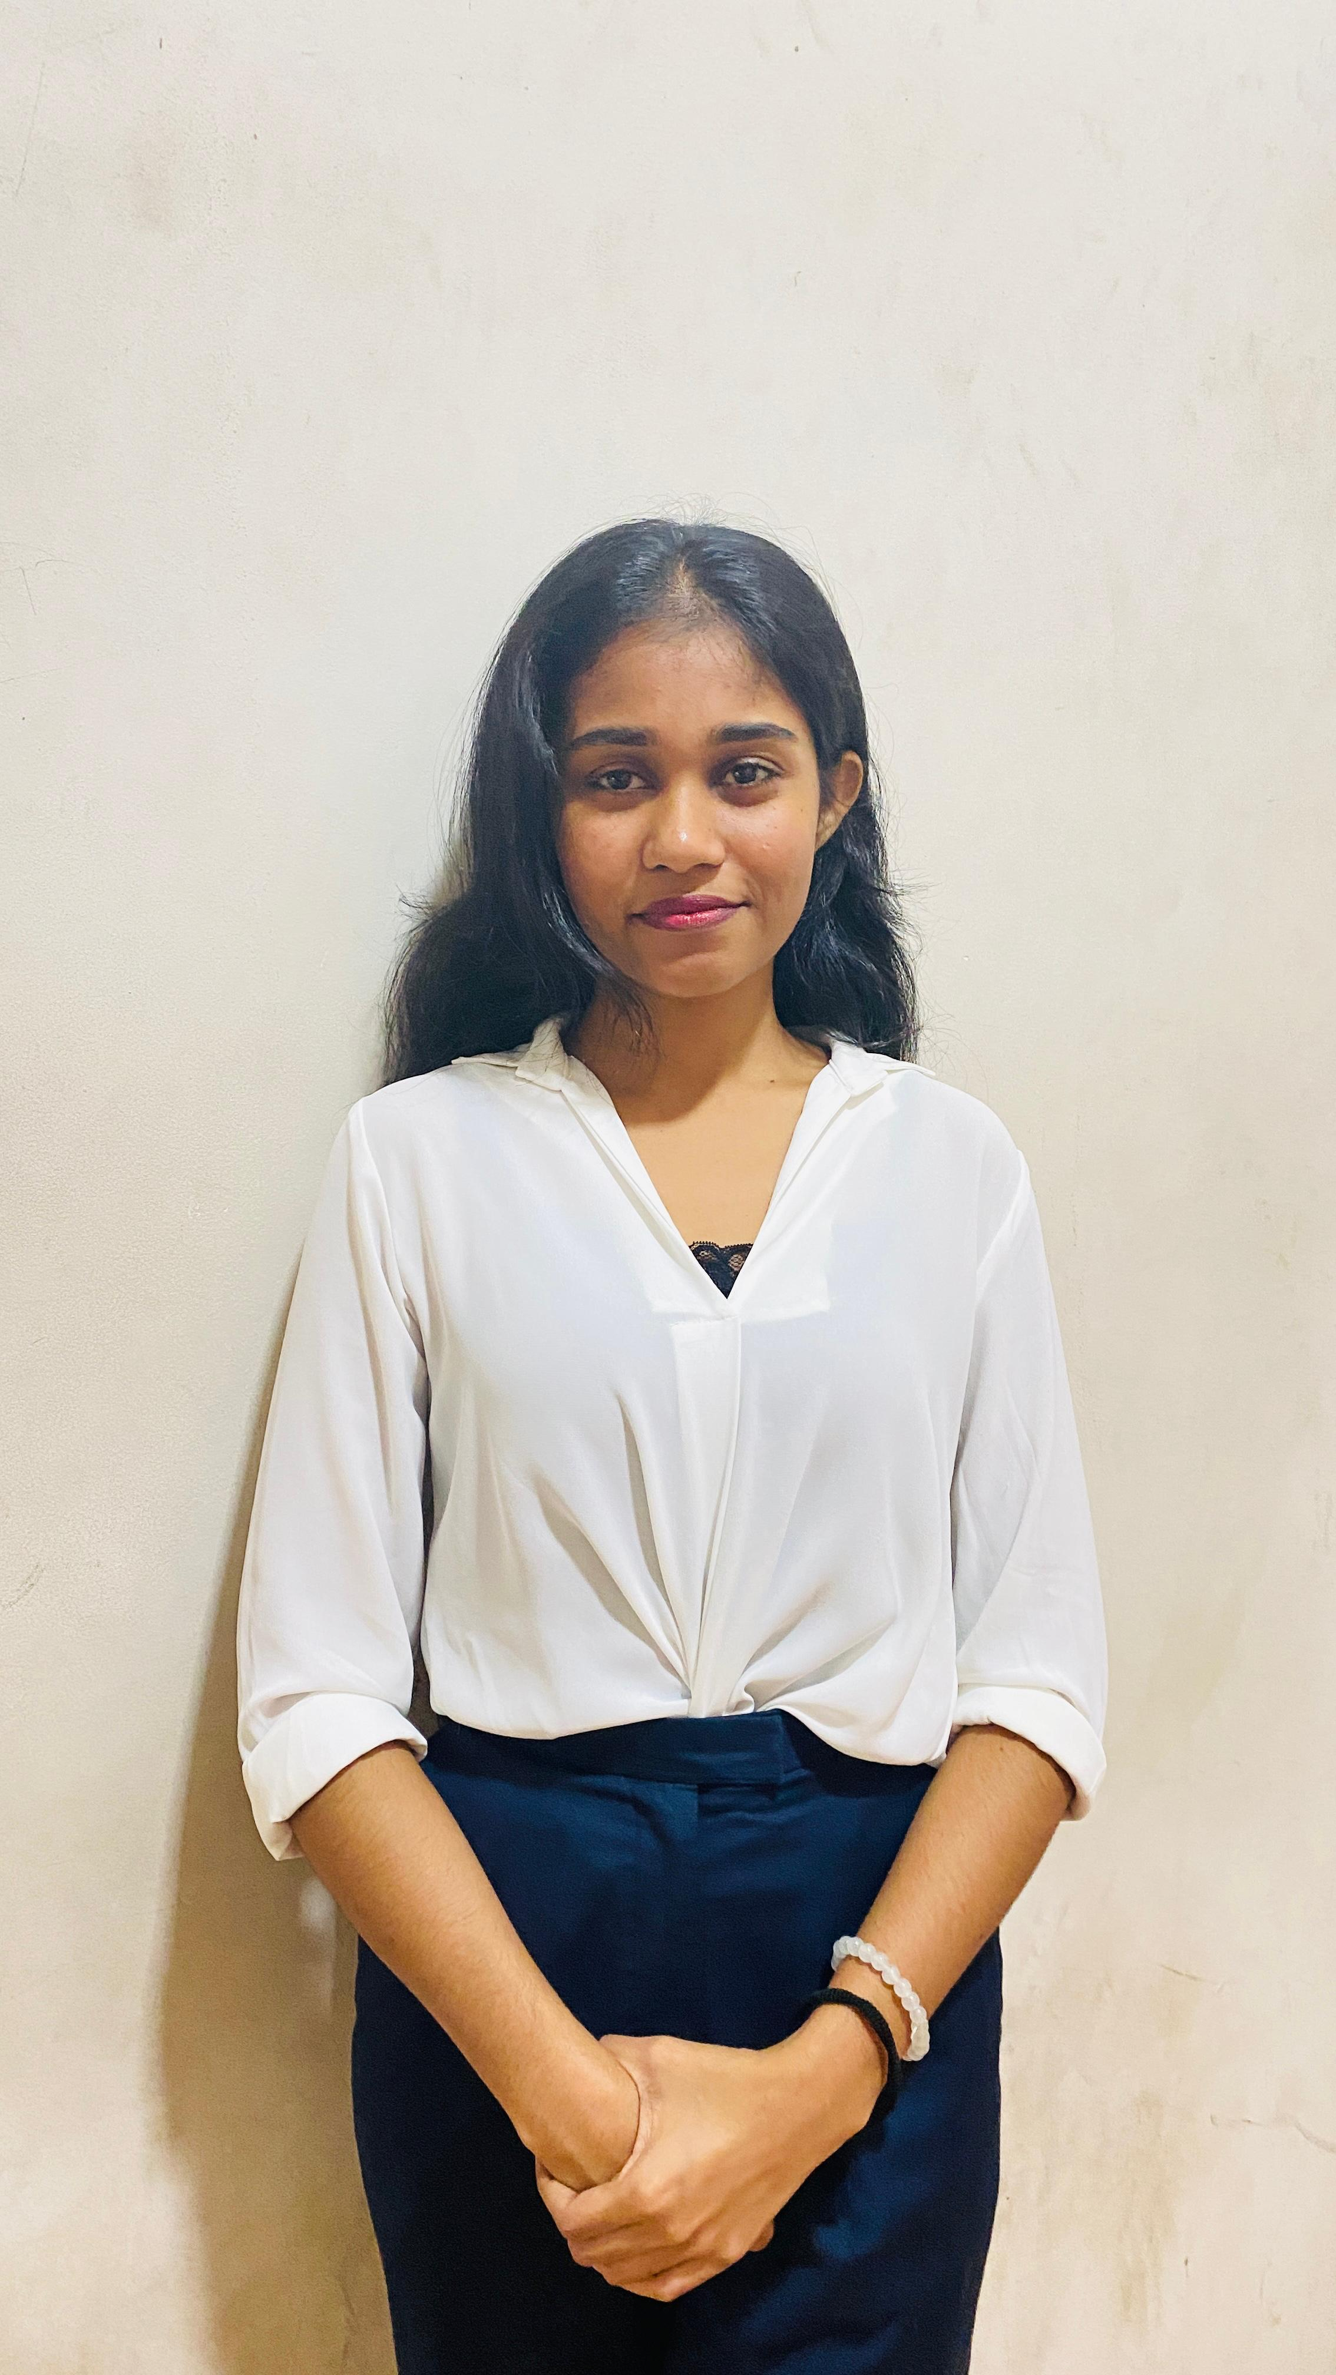
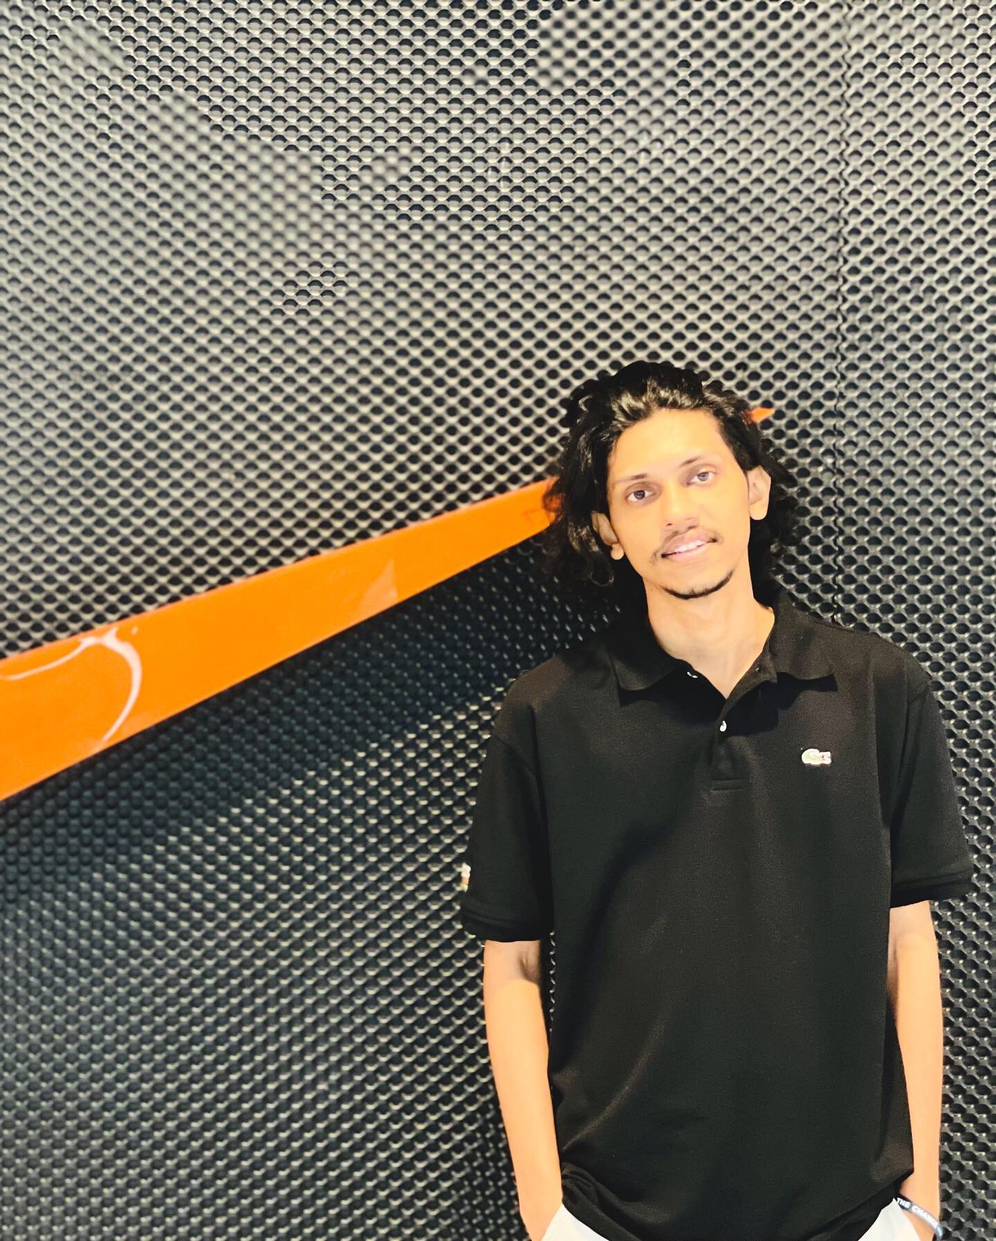
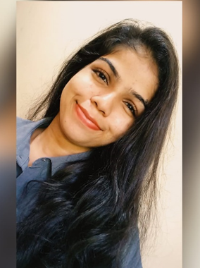

Meet the Team
Madusanka D.A.H
IT21245824
Liyanaarachchi L.A.I.T
IT21207686
Herath H.M.H.C
IT21258862
Rathnasekara W.H.P.
IT21304392

Slide 4
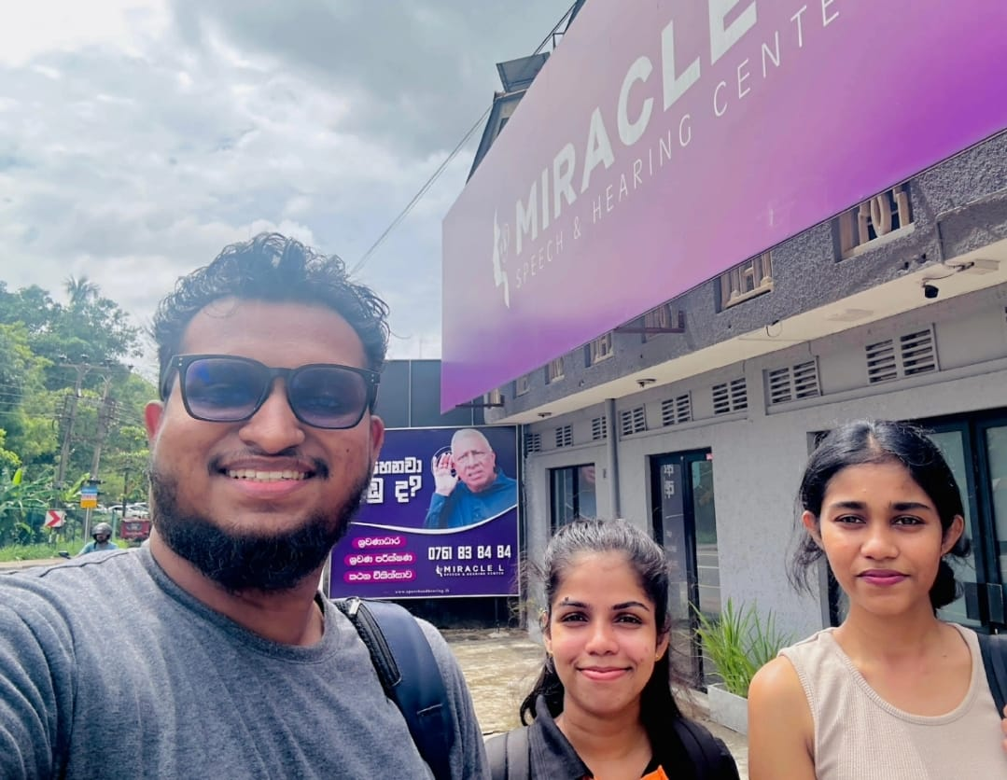
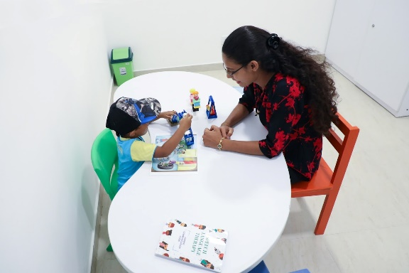
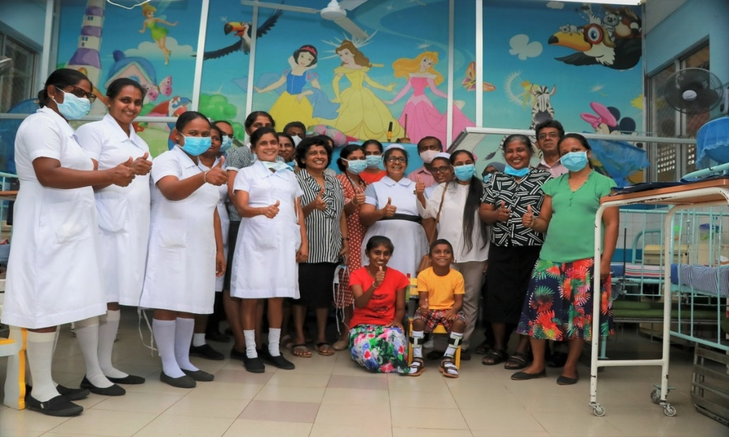
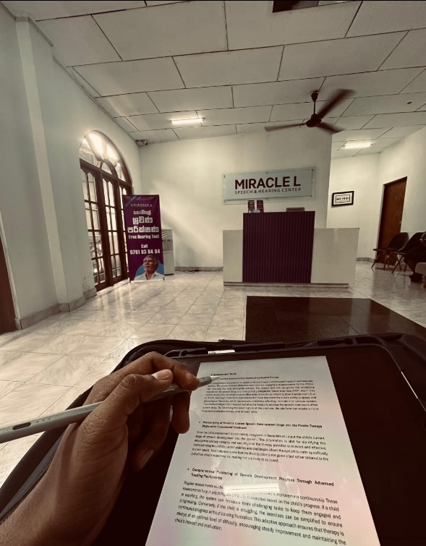
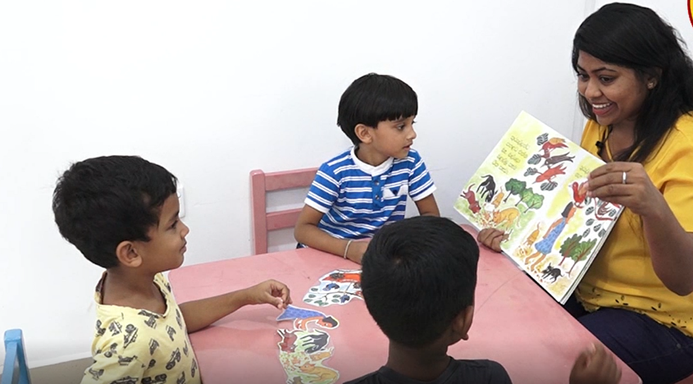
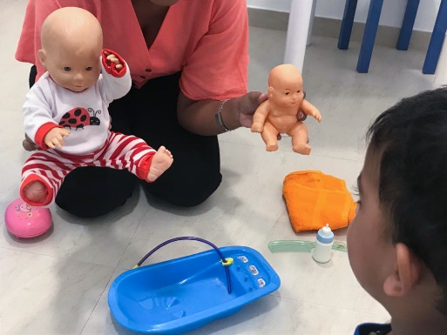
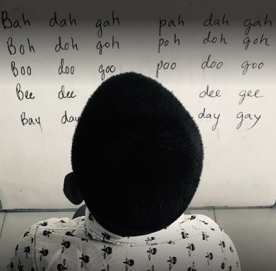
Snaps from the Field Visits

Slide 5
Introduction to the Overall Project
For kids with speech difficulties between the ages of one to three or four, speech therapy is an essential intervention
These illnesses may result from a multitude of causes, such as ENT disorders, psychological trauma, and Neurological disorders.
Main 3 categories
ENT Disorders – Cleft Palate, Language delay, Hearing Loss
Neurological Disorders – Autism, Dysarthria, fascia, guttering
Psychological Trauma - Due to shock, intellectual disabilities, Selective mutism
There is a special unit in Lady Ridgeway children hospital. – “Pediatric Speech Therapy department "
Hospital treatment is not enough to improve their speech ability.
Doctors recommend parents to practice relevant speech therapy exercise at home.
Avaz App – unable to provide expert speech therapy treatments and not available main features like sound expansion, Parallel talk (not using AAC concept- Augmentative and Alternative Communication Cencept)

Slide 6
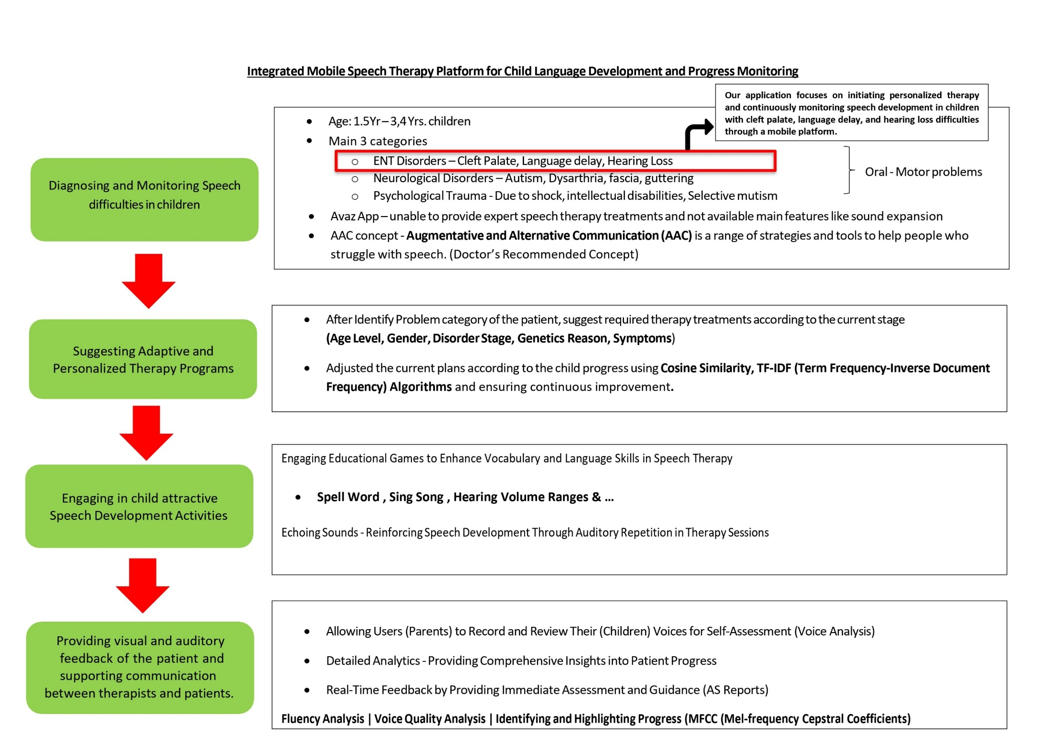

Slide 7
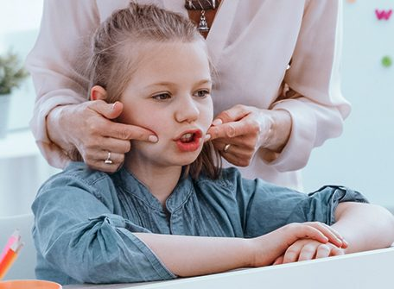
Research Problem
Lots of parents are unable to give their required focus
and treatment activities to their children
lack of necessary expertise
parents busy scheduling
Doctors cannot identity a significant progress of these treatment.

Slide 8
Main Objective
The platform aims to provide personalized, engaging, and adaptive therapy interventions that effectively improve speech and language abilities.

Slide 9
Sub Objectives
Detecting
Detecting Personalized Therapy Initiation and Continuous Monitoring through the platform
Suggesting
Suggesting Adaptive and Personalized Therapy Programs
Engaging
Engaging in Comprehensive and Child attractive Speech Development Activities
Providing
Providing visual and auditory feedback of the patient and supporting communication between therapists and patients.

Slide 10
Methodology
Needs Assessment:
Conduct a comprehensive needs assessment to identify the specific requirements and challenges faced by children with speech disorders.
Platform Development:
Develop a mobile platform that integrates assessment tools, personalized therapy plans, and adaptive learning mechanisms.
Data Collection and Analysis:
Collect real-time performance data during therapy sessions to analyze the child's progress and adjust therapy plans accordingly.
Algorithm Design:
Design and implement adaptive algorithms that modify exercise difficulty based on the child's performance, maintaining the appropriate level of challenge.
User Testing and Feedback:
Conduct user testing with children and therapists to gather feedback and refine the platform's features and functionality.

Slide 11

IT21245824 | Madusanka D.A.H.
Information Technology

Slide 12
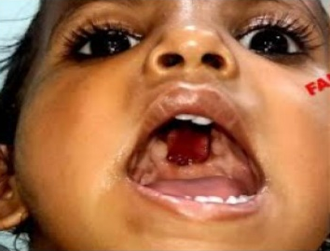
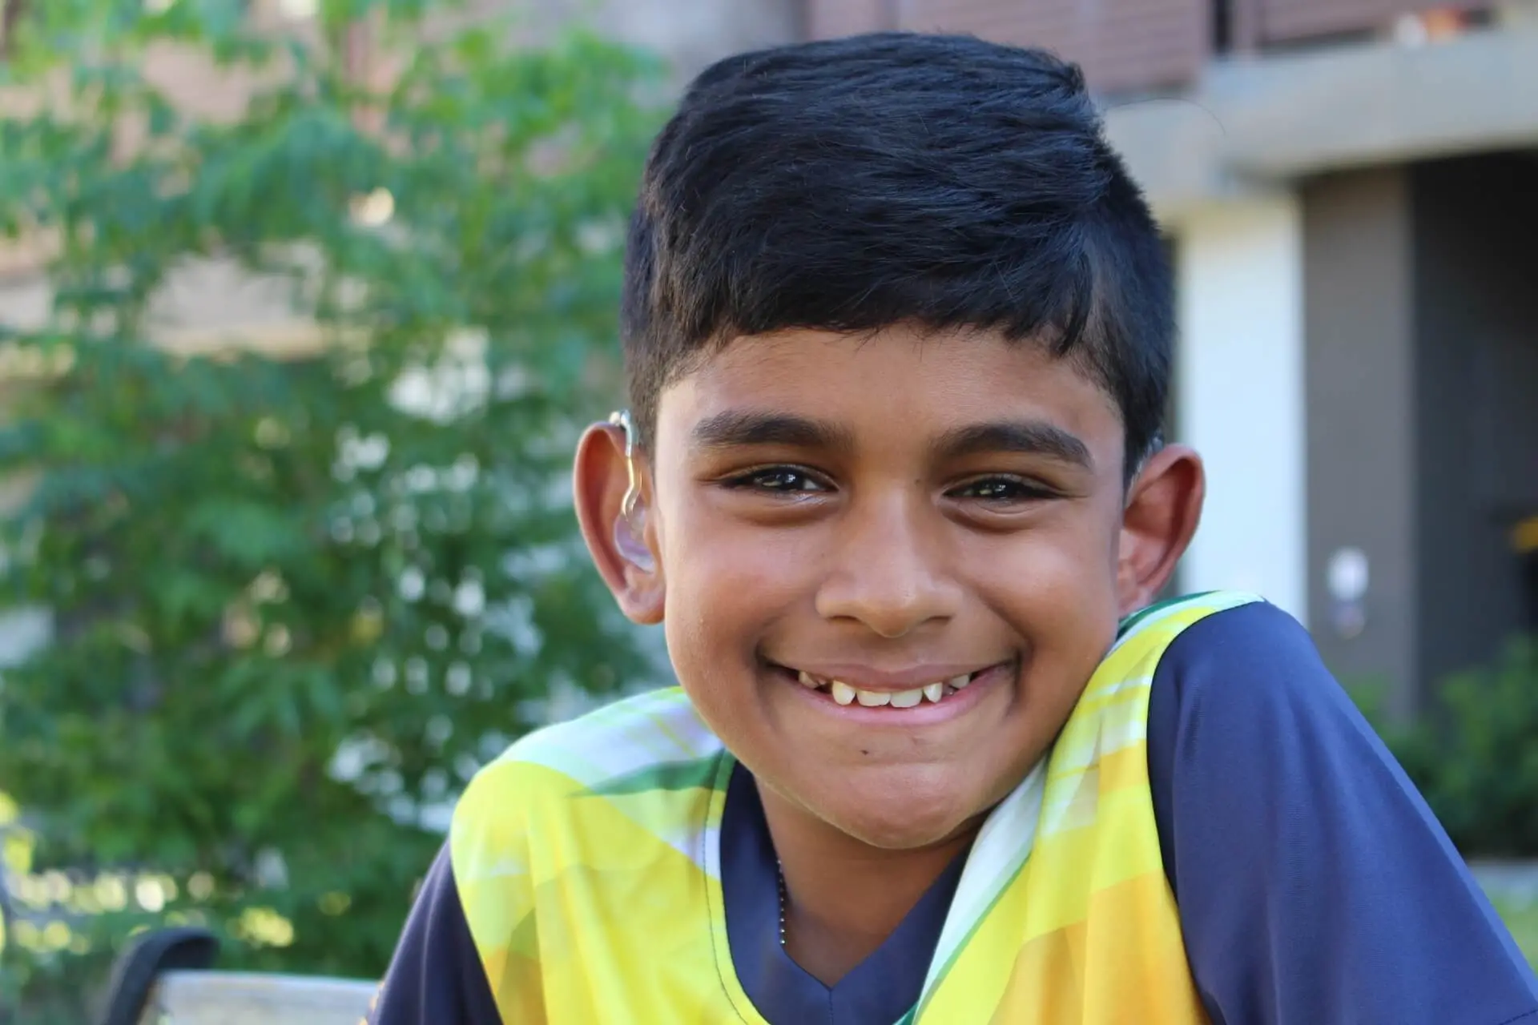
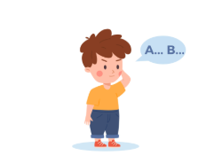
Introduction
Diagnosing and Monitoring Speech difficulties in children
This component of the research project focuses on initiating personalized therapy and continuously monitoring speech development in children with cleft palate, language delay, and hearing loss difficulties through a mobile platform
Utilizing age-appropriate and difficulty based interactive diagnosing tests to ensure accurate diagnosis and active participation in identifying speech issues.

Slide 13
Research Problems
Difficulty Monitoring Progress
Challenges in tracking the child's speech development and effectiveness of interventions
1
Limited Access to Resources
Potential lack of knowledge about effective speech therapy techniques or professionals
2
Financial Burden
Possible high costs associated with frequent therapist visits and evaluations
3
Time Constraint
Balancing therapy sessions with other family responsibilities can be challenging
4

Slide 14
Main Objective
Diagnosing, and monitoring children with speech difficulties based on the specific type of disabilities.

Slide 15
Sub Objectives
Providing age-appropriate and speech difficulty based diagnosing tests to identify speech issues
Categorizing patients’ specific speech difficulties
Cleft Palate
Language Delay
Hearing Loss

Slide 16
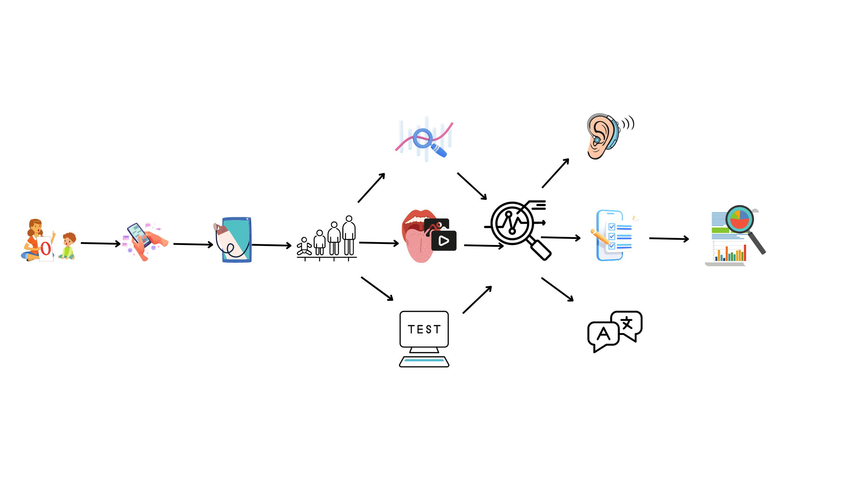
System Diagram
Analyzing
Age appropriate
Tests
Mobile App
Parent(User)
Diagnosing
Difficulties
Generate Report of child speech difficulty details
Categorizing Difficulties
Identifying relevant difficulty

Slide 17
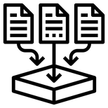





Methodology
Data collection
Used Lightweight Architecture (Flask Microservice, Single Endpoint) for training models
Data pre-processing
Data Visualization
Real-Time Object Detection
Host the finalized model in the flask server
Error Handling
Displayed the results in mobile application

Slide 18
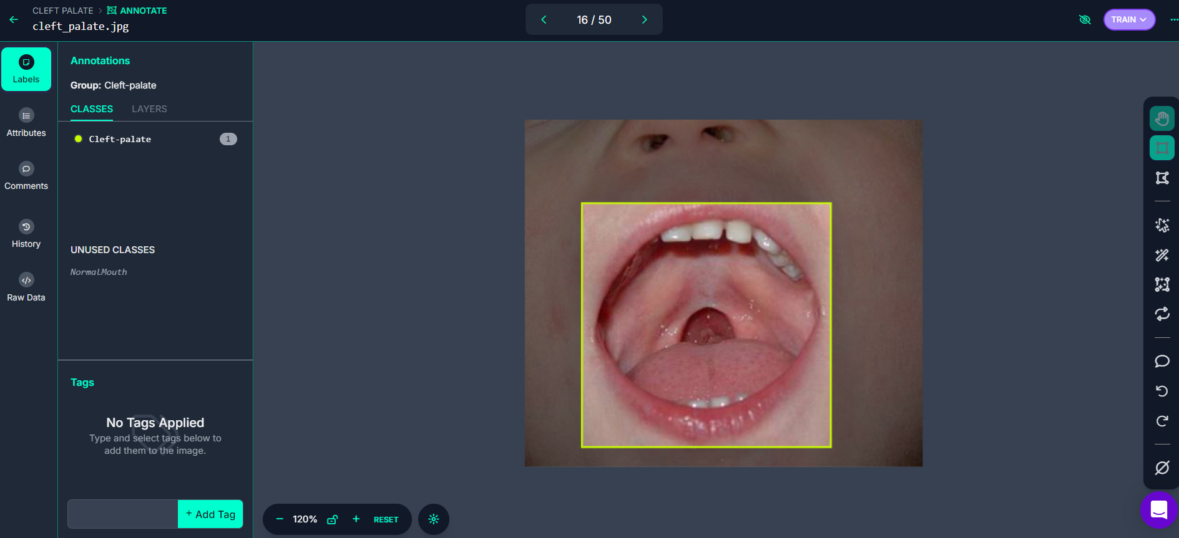
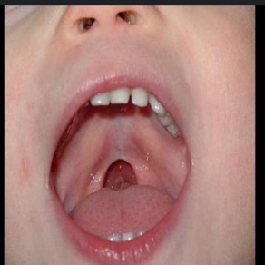
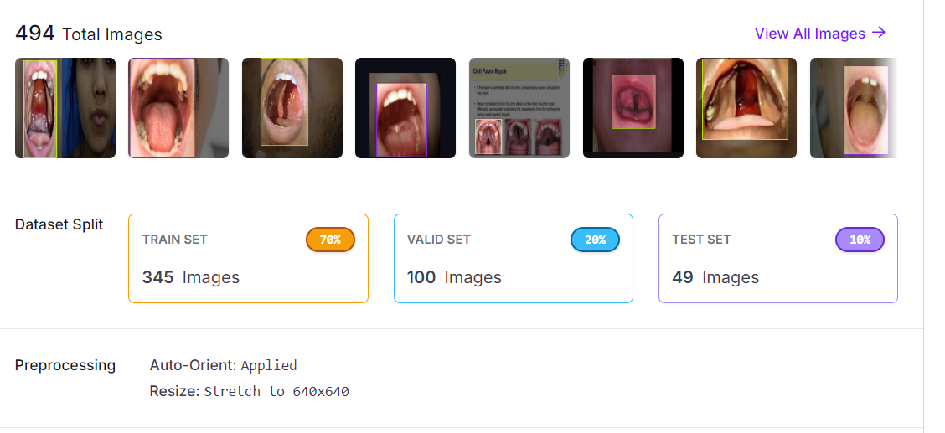
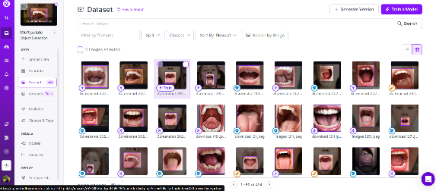
Data Collection and Pre-processing
Summary
Train labels: Teach the model
Validation labels: Tune the model
Test labels: Evaluate the model's performance
Before Data Annotation
After Data Annotation
Why Use Roboflow?
Simplifies Data Preparation (it easier to clean, label, and organize image datasets)
Supports Various Formats (for compatible with YOLO Model )
Enhances Data (to improve dataset quality, such as resizing images& …)

Slide 19
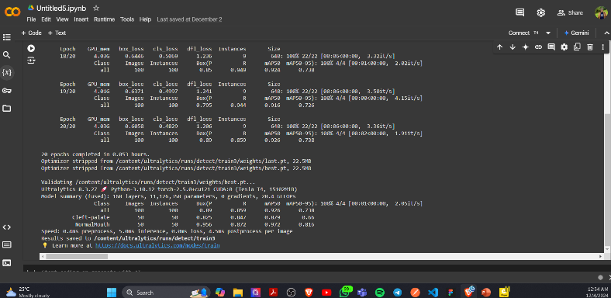
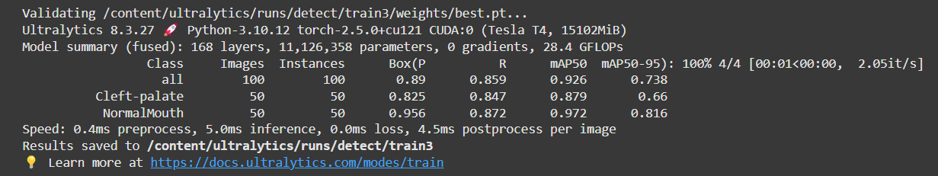
End-to-End Data Training Workflow Using Google Colab
Output of training a YOLO object detection model using Google Colab
Model Performance
The model performs well with a high mAP50 of 92.6%, indicating good detection accuracy
Dataset Size
The dataset consists of 100 images evenly split between two classes

Slide 20
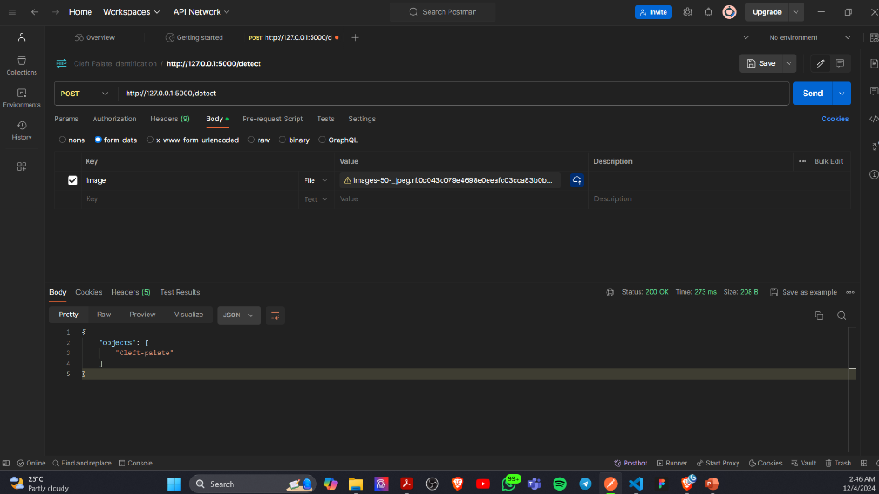
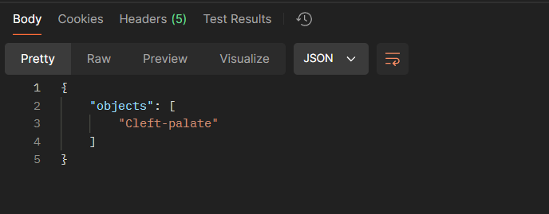
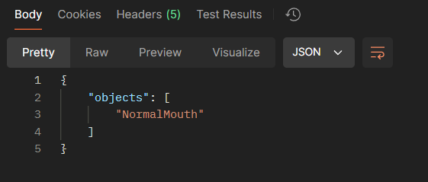

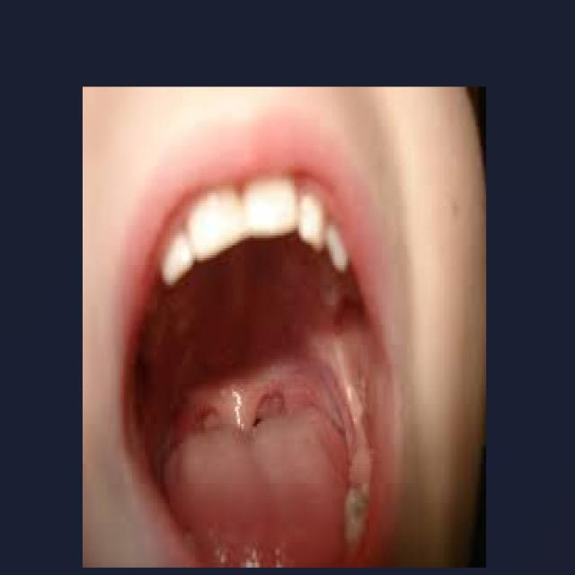
Deploying a YOLO Model for Object Detection Using Flask and Postman
(Cleft-Palate Detection)
(Normal Mouth Detection)
Image Input → Flask API → YOLO Model → JSON Response
Testing phase of a deployed YOLO object detection model via a Flask API
Postman is used as the client tool to send image files for detection and receive predictions in JSON format
The JSON response from the API
This shows that the model correctly classified the image as a normal mouth/ Cleft Palate mouth

Slide 22



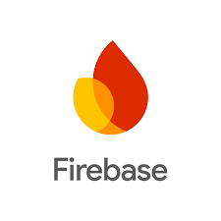
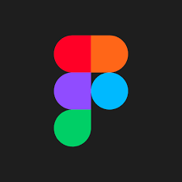
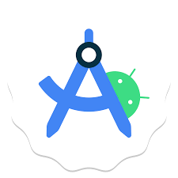



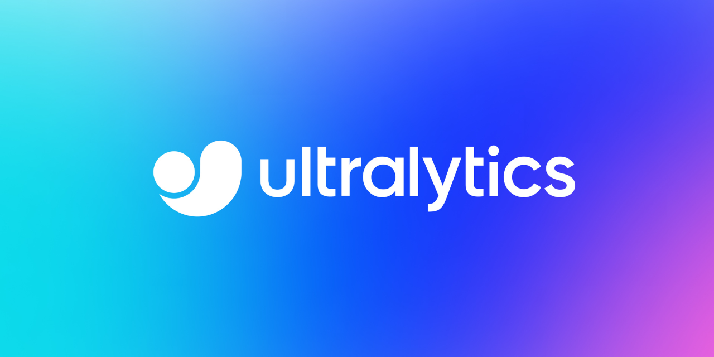
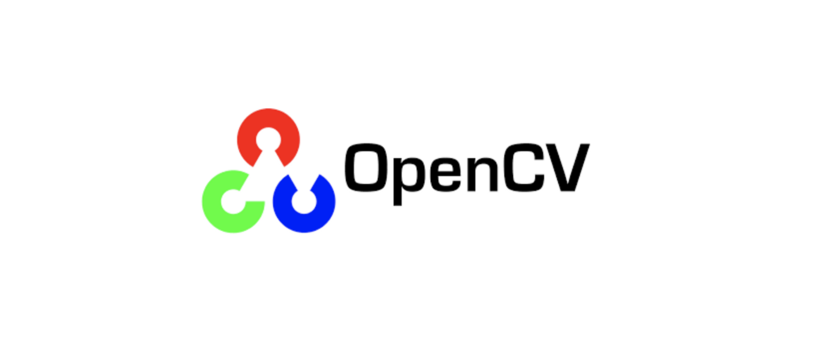
Technologies
Category | Tools/Techniques Used
Algorithms/Models | YOLO8 (Object Detection)
Frameworks/Libraries | Flask, OpenCV, Ultralytics, NumPy
Technologies | Python, YOLO Model File, Google Colab (Data Training), RoboFlow (Data Annotation), Java(Frontend), Figma (Frontend Design), Android Studio
Techniques | Image Preprocessing, Object Detection, Error Handling, JSON API
Database | Firebase

Slide 23


Completion and Future works
55%
Completion of the components
Collected children's mouth images dataset (with cleft palate disability and normal mouth)
Training, Validating and Testing Data Set and Data Annotation
Identify Cleft Palate disability through the mobile application
Designing the Mobile Application Frontend UI Interfaces
45%
Future Implementations
Developing a user-friendly forms to collect data about children’s information and doctor’s reports to categorize language delay and to capture information about hearing impairments
Develop and Implement the mobile application for easy access to the system on Android phones

Slide 24
User Requirements
The platform should be user-friendly and easy for therapists and parents to use.
System should have Age-appropriate visuals and interactive elements and Age-appropriate and difficulty-based testing.
Customizable profiles for each child, including personal details and speech development history
Functional Requirements
The system should be able to evaluate and categorize different types of speech difficulties.
The system should be able to generate graphical representations of the Integrated diagnostic data with user profiles for a comprehensive view.

Slide 25
Non-Functional Requirements
The system should be secure and protect the data collected.
The system should be reliable and maintain a high level of accuracy.
The system should have high user satisfaction and ease of use.

Slide 26
References
Speech Therapy Clinic Section - Lady Ridgeway Hospital for Children
Katha App: Sinhala Phonological Disorder Detection and Treatment in Early Childhood https://ieeexplore.ieee.org/abstract/document/10417279
Interactive, Visual-Learning based Tool for Hearing Impaired Children to Improve Language and Cognitive Skills https://ieeexplore.ieee.org/abstract/document/10225863
Application of Digital Games for Speech Therapy in Children: A Systematic Review of Features and Challenges https://onlinelibrary.wiley.com/doi/10.1155/2022/4814945
A Systematic Review of Online Speech Therapy Systems for Intervention in Childhood Speech Communication Disorders https://www.mdpi.com/1424-8220/22/24/9713
කථන ආභාධ ඇති අයට හ ාඳ ආරංචියක් https://www.youtube.com/watch?v=gI7GEd0QcR4
ඔහේ දරුවා කතා කරන්න ප්‍රමාද ද? ඒ ගැන දැනුවත් හවමු https://www.youtube.com/live/Hj5k-ZUsT6U

Slide 27
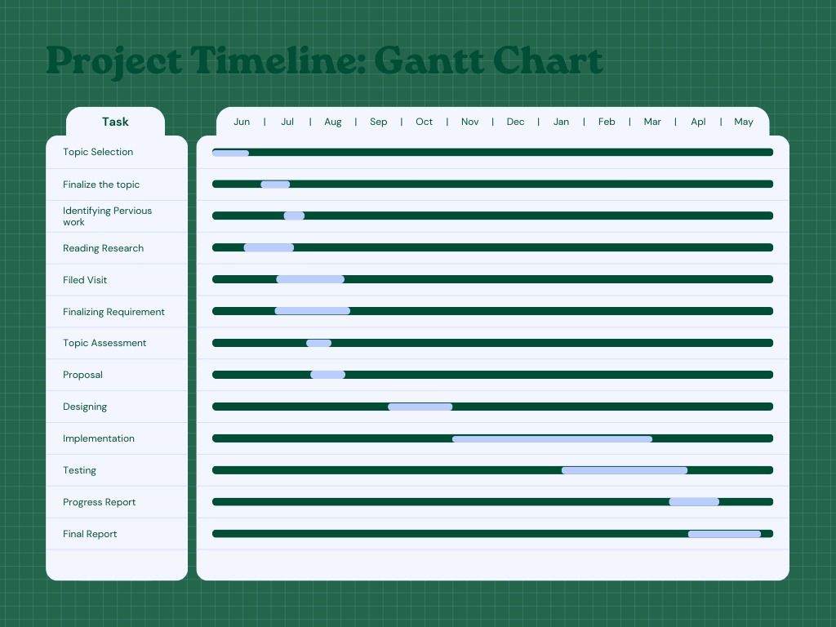

Slide 28
IT21207686 | Liyanaarachchi L.A.I.T.
Information Technology

Slide 29
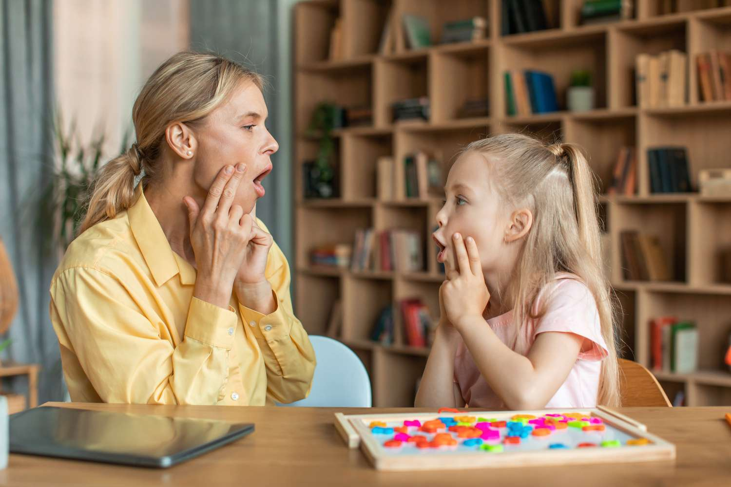
Introductions to Background
Speech therapy supports early communication, learning, and social skills, preventing academic and social difficulties effectively.
Challenges in Traditional Therapy Approaches- Many speech therapy programs use generic methods, neglecting individual needs, reducing effectiveness for articulation and fluency disorders.

Slide 30
Research GAP
Most speech therapy apps don't provide customized therapy plans based on needs.
There is a lack of integration between customized therapy plans and interactive exercises within a single platform.
Many apps do not prioritize user-centric design, which can affect the engagement and effectiveness of therapy

Slide 31
Features | A: Computer-Assisted Screening for Speech and Language Delay | B: Technology-Assisted Speech Therapy | Your Proposed System
Easy-to-use | Yes | Partial | Yes
Personalized Therapy Plans | No | No | Yes
Adaptive Learning Capabilities | No | Yes | Yes
Real-Time Feedback | Yes | Yes | Yes
Engaging Interactive Exercises | Partial | Yes | Yes
Progress Analysis | Yes | Partial | Yes
Customizable Therapy Intervention | No | Partial | Yes
Motivation and Engagement Techniques | No | Yes | Yes
Scalability and Flexibility | Partial | No | Yes

Slide 32
Research Question
How can personalized mobile speech therapy enhance child language development and monitor progress effectively?
Lack of Understanding: Patients and families struggle to follow prescribed treatments and exercises correctly.
“Are you aware of personalized mobile speech therapy solutions for child language development?” - Yes: 35%No: 65%

Slide 33
Main Objective
To develop a system that provides adaptive and personalized speech therapy plan for children aged 1 to 4 and their disorder stage.

Slide 34
Sub Objectives
Customizing Therapy Plans:
Develop personalized therapy plans for each child based on their unique needs and initial assessment results.
Tracking and Progress Monitoring:
Enhancing Speech Therapy Through Real Time Adjustments Based on User Performance

Slide 35
Methodology for Completion of Speech Therapy Plan
Step | Description
Data Collection | Gathered data on age, gender, region, disorders, symptoms, causes, and therapy plans from reliable sources.
Data Preprocessing | Cleaned and processed data, handled missing values, and encoded categorical variables using LabelEncoder.
Feature Engineering | Selected relevant features based on their importance and relevance to the therapy plan.
Model Training | Trained a Random Forest Classifier on the processed data to predict therapy plans.
Model Evaluation | Evaluated the model using metrics like accuracy, precision, recall, and F1-score.

Slide 36
Model Deployment of Speech Therapy Plan
Step | Description
Model Serialization | Saved the trained Random Forest model and label encoders using pickle for deployment.
API Development | Created a RESTful API using Flask for real-time interaction with the machine learning model.
Testing | Tested the Flask API locally to ensure functionality and accurate predictions.
Deployment | Deployed the Flask server and pre-trained model on AWS EC2 instances for scalability and accessibility.

Slide 37
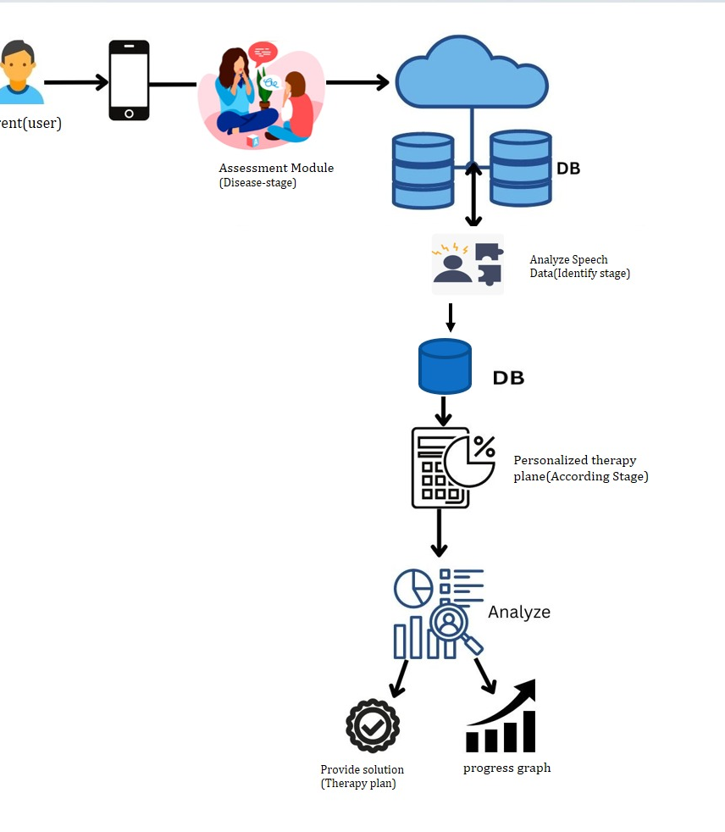
System Diagram

Slide 38


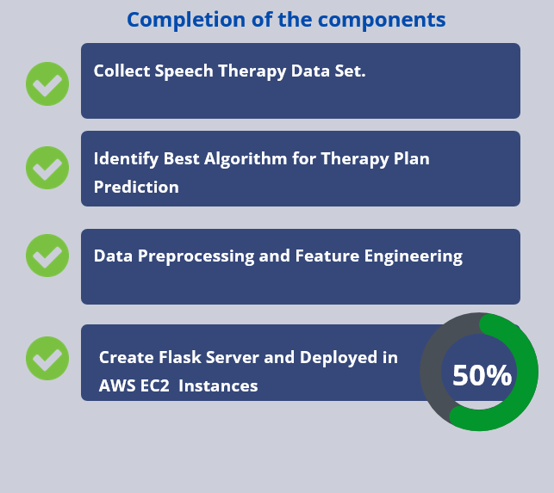
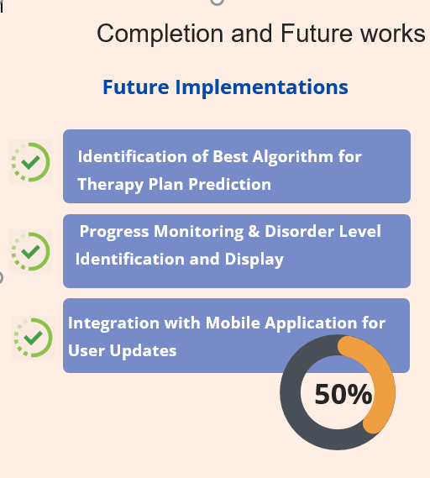

Slide 39
Functional Requirements
System should generate a tailored therapy plan based on input data, including age, gender, region, and specific symptoms.
Recommend personalized interactive exercises, such as word repetition or sentence structuring, based on detected disorders.
Adaptive learning should dynamically change exercise difficulty based on the child's progress.

Slide 40
Non-Functional Requirements
Higher Accuracy Of results.
Should properly work for IOS and Android devices.
The system should ensure data security and privacy, protecting children's information and therapy progress.
Application should be reliable
Interfaces should be more user-friendly.

Slide 41
Technologies, Techniques, Algorithms
Category | Details
Technologies | Flask, Google Colab, Python
Libraries | Pandas, Scikit-learn, Pickle
Architecture | Monolithic Client-Server Architecture
Algorithm | Random Forest Classifier
Techniques | Label Encoding, Train-Test Split, Model Serialization, REST API

Slide 42
Algorithm | Purpose | Where Used
Random Forest Classifier | Predict therapy plans based on input features. | Machine Learning Model
Label Encoding | Convert categorical features into numeric values. | Data Preprocessing
Accuracy Score | Evaluate model's overall prediction accuracy. | Model Evaluation
Classification Report | Provide detailed performance metrics per class. | Model Evaluation
Train-Test Split | Split dataset into training and testing sets. | Data Preparation

Slide 43
References
Robles-Bykbaev, V. E., López-Nores, M., Pazos-Arias, J. J., & Arévalo-Lucero, D. (2015). SPELTA: An expert system to generate therapy plans for speech and language disorders. Expert Systems With Applications, 42(21), 7641–7651. https://doi.org/10.1016/j.eswa.2015.06.011
Saeedi, S., Bouraghi, H., Seifpanahi, M.S. and Ghazisaeedi, M., 2022. Application of digital games for speech therapy in children: a systematic review of features and challenges. Journal of healthcare engineering, 2022(1), p.4814945.
Attwell, Geertruida Aline, Kwabena Ebo Bennin, and Bedir Tekinerdogan. "A systematic review of online speech therapy systems for intervention in childhood speech communication disorders." Sensors 22.24 (2022): 9713.
Bernhardt, B., Gick, B., Bacsfalvi, P., & Adler‐Bock, M. (2005). Ultrasound in speech therapy with adolescents and adults. Clinical Linguistics & Phonetics, 19(6–7), 605–617. https://doi.org/10.1080/02699200500114028

Slide 45
IT21258862 |Herath H.M.H.C
Information Technology

Slide 46
Introduction
My component focuses on developing interactive and educational activities tailored to three key categories:
Cleft Palate, Language Delay, and Hearing Loss
Spell Word Activity - Cleft Palate
Sing Song Activity - Language Delay
Hearing Volume Ranges Activity - Hearing Loss
These games make therapy engaging and effective for young children aged 1-4.

Slide 47
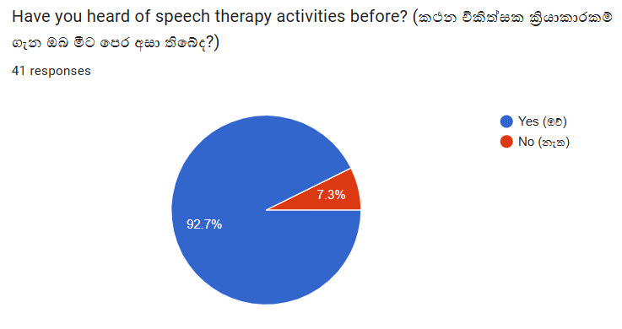
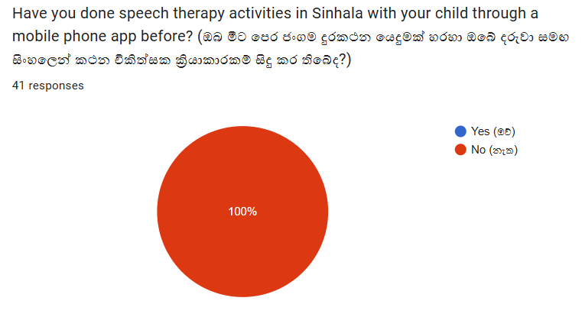
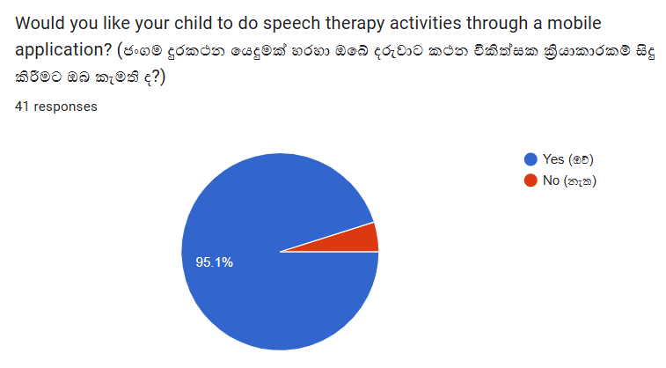
Research Question
How do we know that people are aware of speech therapy activities?
How do we find out if people are already doing speech therapy activities through a mobile application?
How do we create speech therapy activities to support the Sinhala language?
How do we confirm that parents are willing to conduct speech therapy activities for their children through a mobile application?

Slide 48
Specific and Sub Objective
Speech therapy activities are categorized according to main speech disorders.
Design song-based activities to boost vocabulary and sentence skills for children with language delays.
Develop activities that encourage children with cleft palate to articulate words correctly.
Design games to help children with hearing loss identify and differentiate various sound volumes
Engage children in effective speech therapy with colorful visuals and animations under parental guidance.
After completing the levels of speech therapy activities, parents can monitor the child's level according to the score level.
Making speech therapy fun, easy and accessible for children anytime, anywhere.

Slide 49

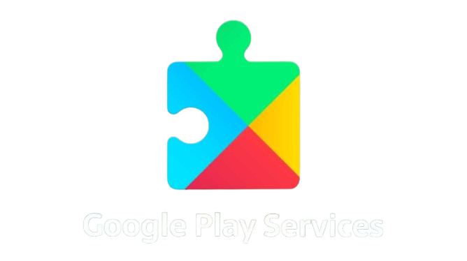



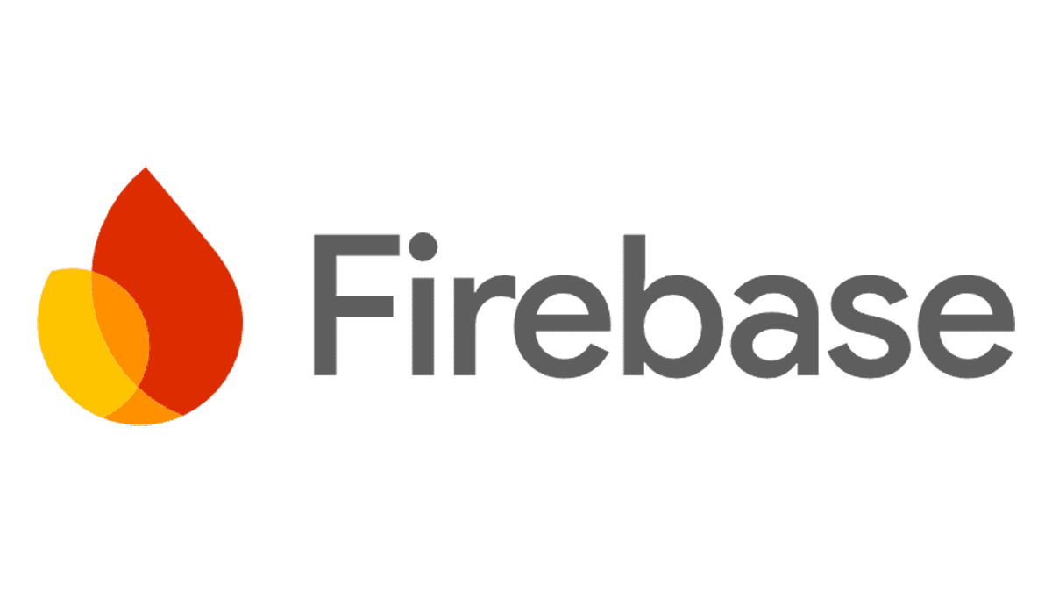
Technologies & Techniques
Technologies
Java Programming Language
Firebase SDK
XML Layout
Event-Driven Programming
Android Studio
Techniques
Role-Based Navigation
Asynchronous Data Fetching
UI State Management

Slide 50
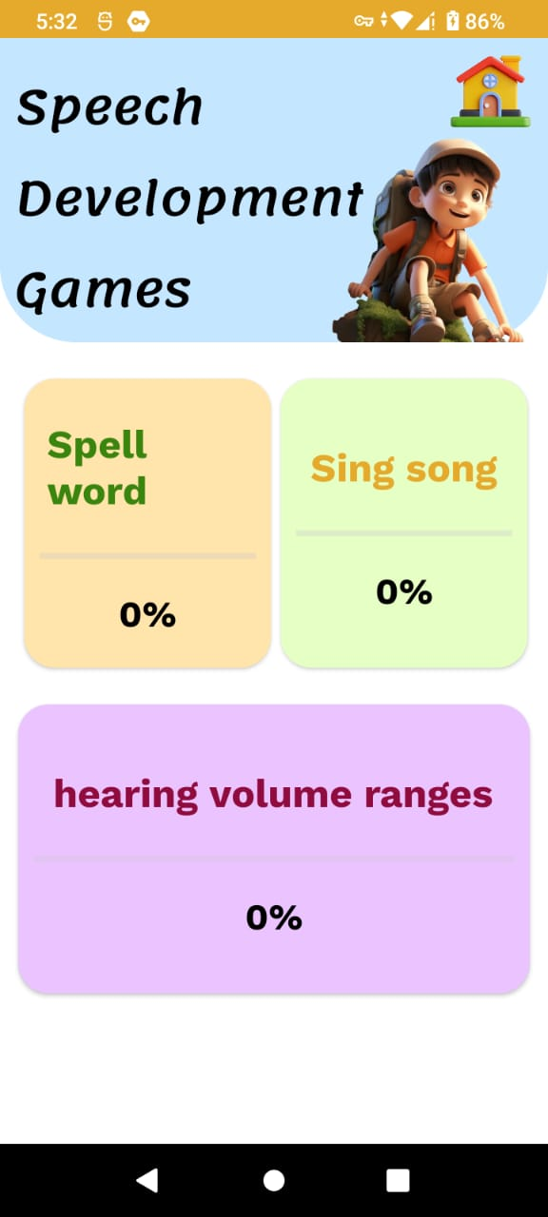
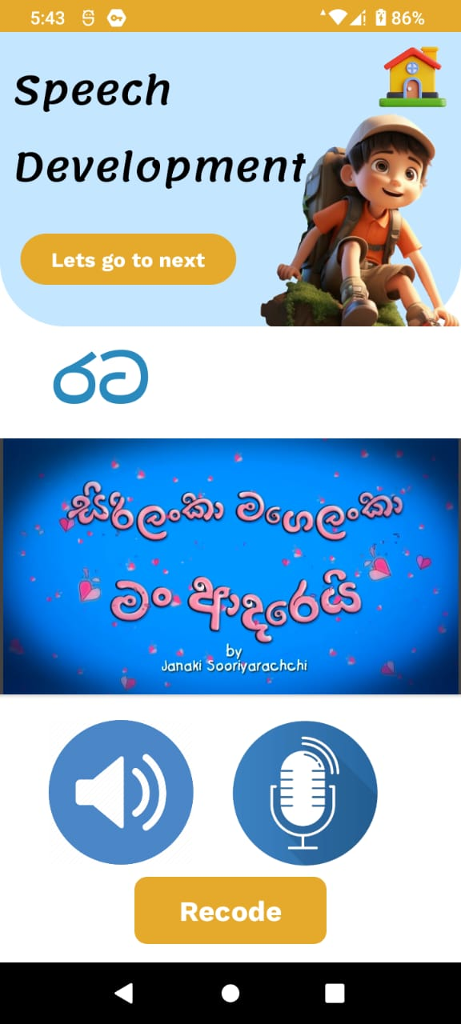
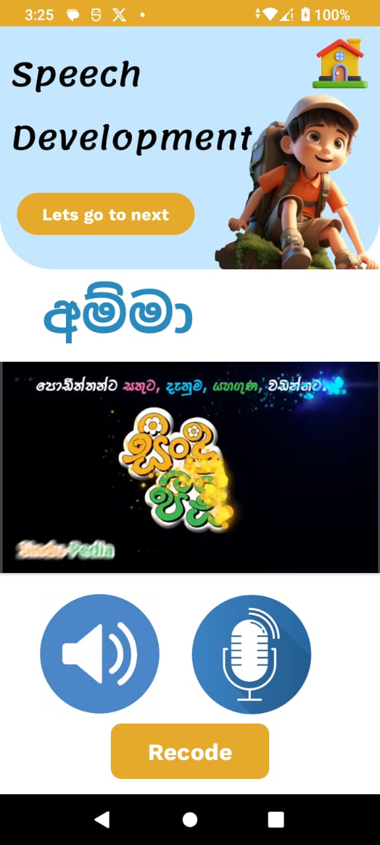
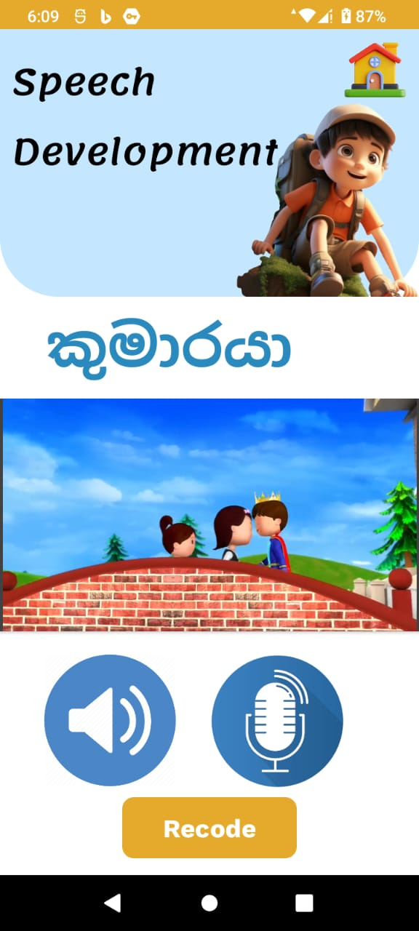
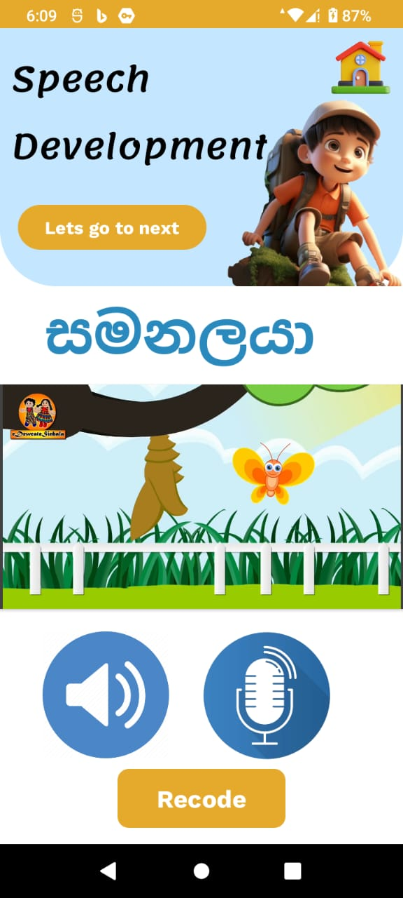
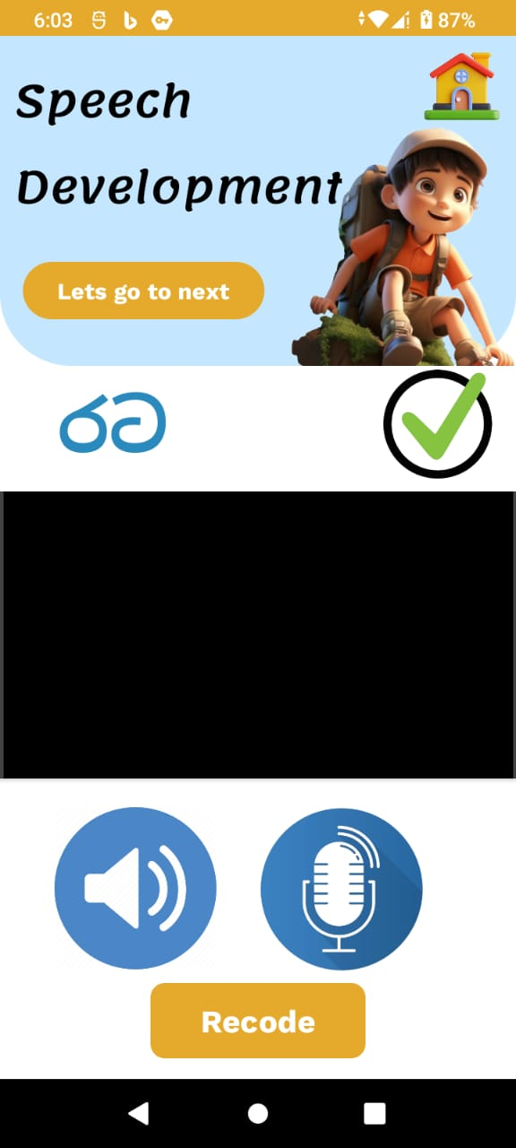


Current Progress
Spell Word Activity (Cleft Palate): Helps children practice clear pronunciation through fun spelling exercises.
Games
From 2 letters to progressively more complex words
A correct sign is placed in front of correctly pronounced words
If necessary, you can record the pronounced word
At the end, the score will be displayed

Slide 51






Current Progress
2. Sing Song Activity (Language Delay): Uses songs and rhythms to support language development.
Song 1 with video
Try song 1
Pronounced line 1 correctly
Line is not pronounced correctly
Dropping star marks to correct lines
Number of correct answers will pop-up

Slide 52




Current Progress
3. Hearing Volume Ranges Activity (Hearing Loss): Improves auditory awareness by identifying different volume levels.
There are several sounds in which the number of hertz gradually increases
A tick can be placed in front of the number of hertz heard
Save the number of hertz that you hear correctly
The number of marks obtained for the activity is displayed

Slide 53


Project Evidence
Gathered captions from surveys
Implement the codes

Slide 54



Project Evidence
Output of coding
Data storage in Firebase
Use Text-to-Speech method

Slide 55
Functional, Non-Functional and User Requirements
Functional Requirements
The system should display the speech therapy activities according to main key categories.
The system should be able to identify correct pronunciation of the word or line.
The system can suggest funny activities such as funny videos and cartoons according to the required level of speech therapy.
Non-Functional Requirements
The system should be reliable
User friendly
The system should be secure and protect the data collected.
User Requirements
The system should be easy to use and understand.
The system should be able to provide accurate speech therapy activities.
Provide a secure and ad-free environment for children.
Collect minimal user data, ensuring compliance with child data protection standards.

Slide 56
Next Expected Progress
Expanded Game Library:
Develop additional games targeting more specific speech therapy needs, such as sentence building.
2. Enhanced Visuals and Audio:
Upgrade graphics and sound effects to make the games more appealing to young children.
3. Progressive Difficulty:
Implement gradual increases in difficulty levels within each game to align with the child’s improvement.
12/4/2024
56

Slide 57


References
[1] Avaz application
https://play.google.com/store/apps/details?id=com.avazapp.international.lite
[2] Katha App: Sinhala Phonological Disorder Detection and Treatment in Early Childhood https://ieeexplore.ieee.org/document/10417279
[3] Games-Based Therapy to Stimulate Speech in Children. Available: https://www.researchgate.net/publication/300231457_Games-Based_Therapy_to_Stimulate_Speech_in_Children?enrichId=rgreq-739215bd48bdce8d190bcccba0f288a0-XXX&enrichSource=Y292ZXJQYWdlOzMwMDIzMTQ1NztBUzo1OTkyOTcyMjE0NTk5NjlAMTUxOTg5NTAwMDk3OQ%3D%3D&el=1_x_2&_esc=publicationCoverPdf
[4] Application of Digital Games for Speech Therapy in Children: A Systematic Review of Features and Challenges . Available: https://pubmed.ncbi.nlm.nih.gov/35509705/

Slide 59

IT21304392 | Rathnasekara W.H.P.
Specialization : Information Technology

Slide 60

Introduction Background

Slide 61


Research Question
The main reason for this is that the professional therapists take more time to examine the child and provide treatment, and the clinical session is only once a month.
As a solution to such cases, therapist-patient interaction is successfully done through remote consultation session with real time feedback.
Lack of knowledge about the recommendations of the correct speech therapy techniques and fertilization procedures.
Difficulty in checking progress stages & visualizing data and identifying specific areas needing attention.
Lack of coordinated communication among therapists, caregivers, and parents.

Slide 62


Methodology
Needs Assessment:
Conduct a comprehensive needs assessment to identify the specific requirements and challenges faced by children with speech disorders.
Platform Development:
Develop a mobile platform that integrates assessment tools, personalized therapy plans, and adaptive learning mechanisms.
Data Collection and Analysis:
Collect real-time performance data during therapy sessions to analyze the child's progress and adjust therapy plans accordingly.
Algorithm Design:
Design and implement adaptive algorithms that modify exercise difficulty based on the child's performance, maintaining the appropriate level of challenge.
User Testing and Feedback:
Conduct user testing with children and therapists to gather feedback and refine the platform's features and functionality.

Slide 64


Slide 65



System Diagram

Slide 66


Slide 67


Slide 68


Slide 69


Slide 70


Slide 71


Slide 72
User Requirements
User friendly & easy to navigate
Efficient personalized treatment adjustments, progress stages recommendations based on patient’s status report, preferences and new updated health progress.
Receive Real time feedback, remote consultations
Functional Requirements
Real-time updates of condition of patients.
Dynamic speech therapy Centre layout optimization based on patient’s real time behavior and remote consultation popularity.
The platform will generate progress reports of children's speech therapy monthly wised for validate effectiveness of the system to improve children's speech skill.
72

Slide 73
Non-Functional Requirements
User Friendly
Reliability
Efficiency
Fast and responsive system performance for a remote treatment experience.

Slide 74
References
Katha App: Sinhala Phonological Disorder Detection and Treatment in Early Childhood
https://play.google.com/store/apps/details?id=com.kathaappa.kathaappa&hl=en
https://ieeexplore.ieee.org/document/10417279
Avaz Application:
https://play.google.com/store/apps/details?id=com.avazapp.international.lite&hl=en

Slide 76

Thank you!

